Slide 1
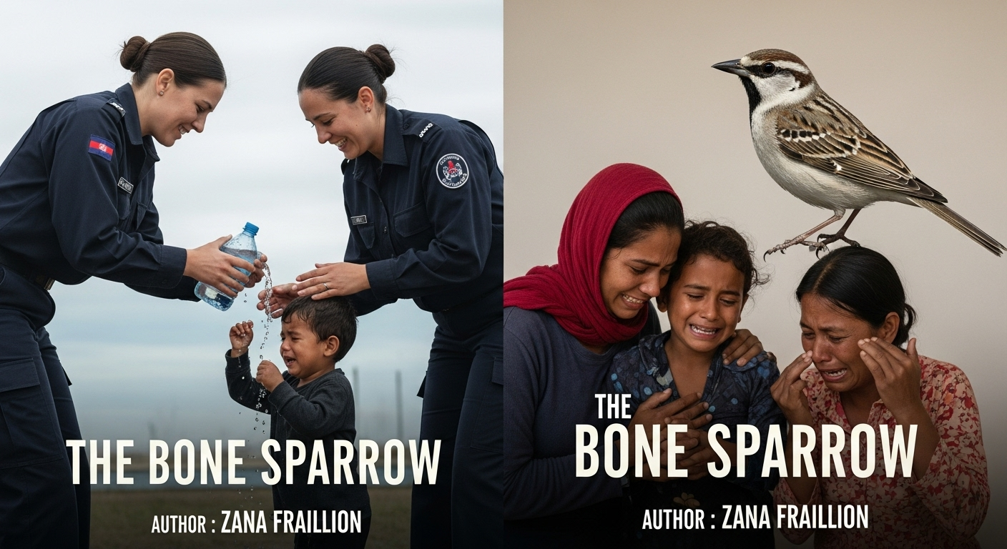
Prompt:
Create 1 image which represent refugees in an Australian Detention Centre being mistreated: It should be in the style of a book cover:
1) This first image should show a guard stealing water from a child and the child and the parents should be seen crying. They are emotional whereas the guards are seen laughing. They are being taken from their home. There should be a bone sparrow in the background and it should be a book cover for the book Bone Sparrow so should have all relevant information.
Title: The Bone Sparrow
Author : Zana Fraillon
The only text on the cover should be the title and the author name

Slide 2
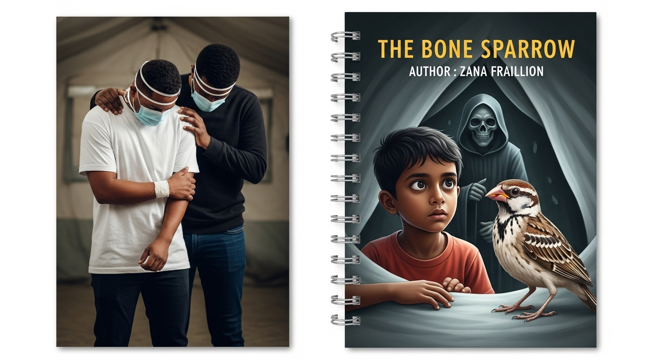
2)
Prompt: Create 1 image which represent refugees in an Australian Detention Centre being mistreated: It should be in the style of a book cover:
2) The Second image should be an image of a young rohingya boy looking at a bone sparrow in a Detention Centre tent. He should look at it as if it was unusual. The Bone Sparrow should look confused. Behind the boy should be a figure of Death, The binding of the book should be visible
Title: The Bone Sparrow
Author : Zana Fraillion
The only text on the cover should be the title and the author name

Slide 3
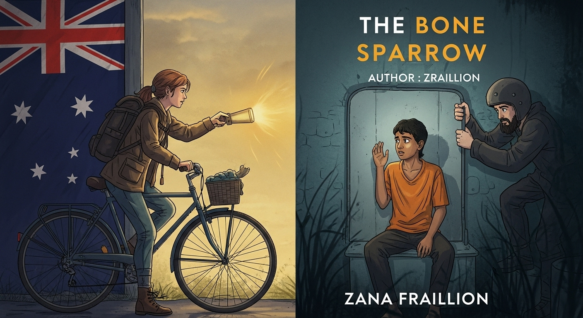
3)
Prompt: Create 1 image which represent refugees in an Australian Detention Centre being mistreated: It should be in the style of a book cover:
2) Imagine an Australian Girl meeting a rohingya boy in the detention centre; She has a bike and a torch and looks like a warrior whereas the rohingya boy looks scared and surprised.
Title: The Bone Sparrow
Author : Zana Fraillion
The only text on the cover should be the title and the author name

Slide 4
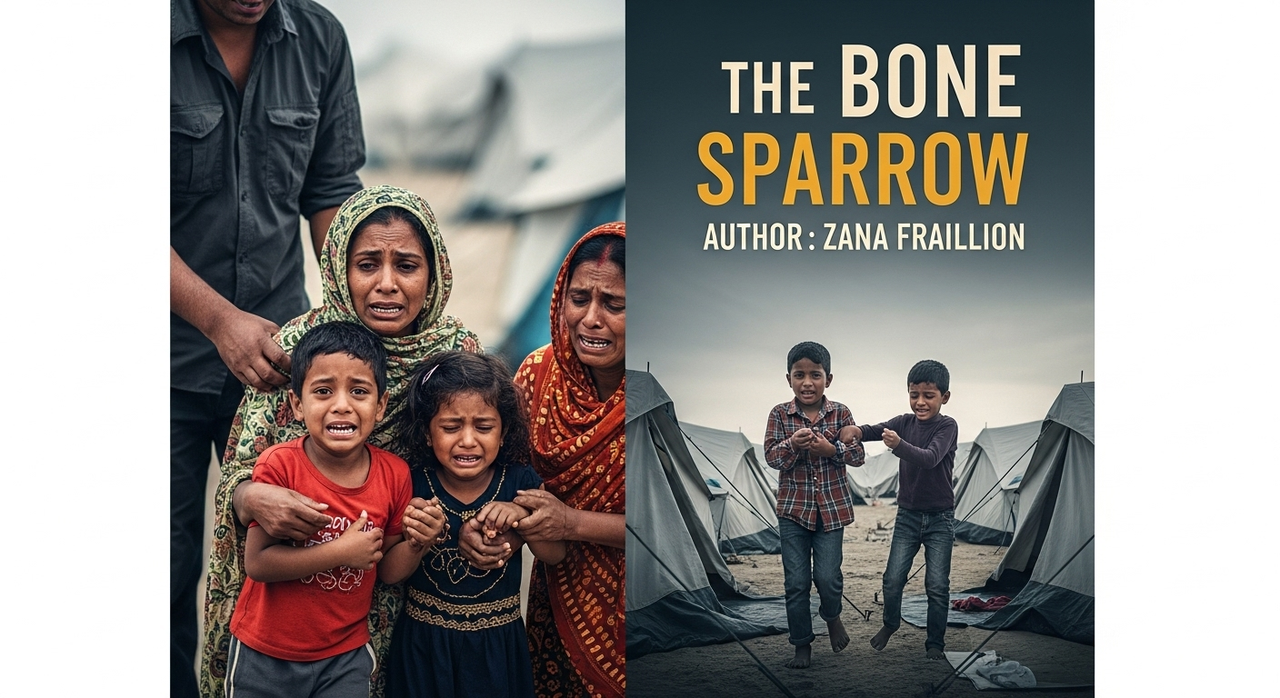
4)
Prompt: Create 1 image which represent refugees in an Australian Detention Centre being mistreated: It should be in the style of a book cover:
4) The final image should show a boy of unknown ethnicity (not rohingya) being dragged away from his tent to join another tent. This boy should be scared and his friends a young rohingya boy and a young rohingya girl and a rohingya mother should be crying with the boy. The person whose dragging him away should show no empathy.
Title: The Bone Sparrow
Author : Zana Fraillion
The only text on the cover should be the title and the author name

